Slide 1
Microsoft .Net Framework with C#
-Kumar Nitesh

Slide 2
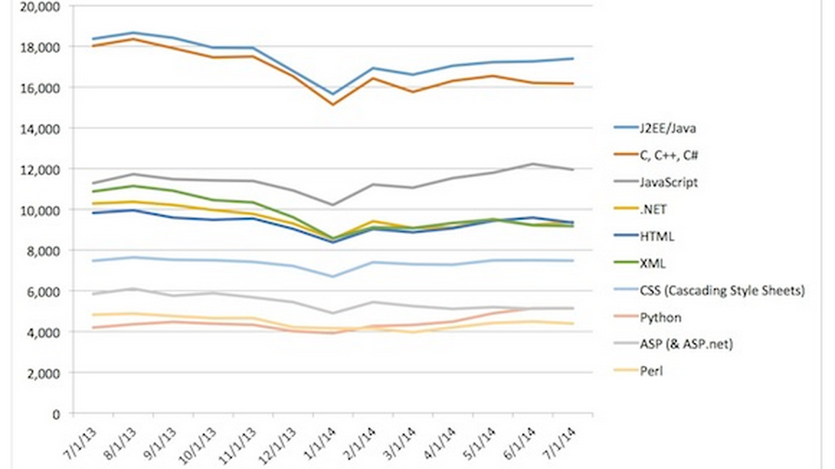
Source : dice.com

Slide 3



Slide 4

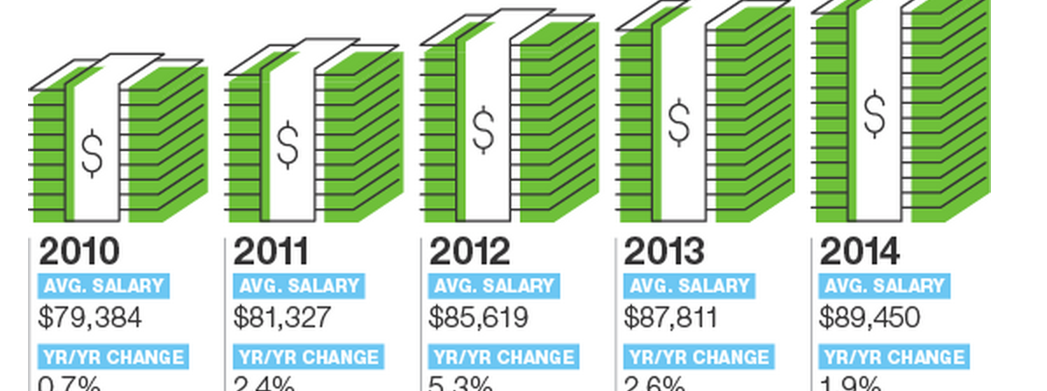
Source: dice.com

Slide 5
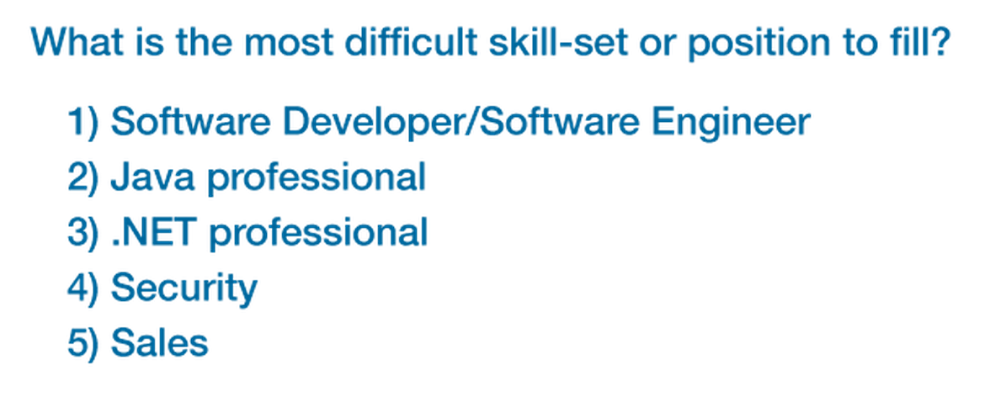
Source : dice.com

Slide 6


.Net Framework
.NET Framework (pronounced dot net) is a software framework developed by Microsoft that runs primarily on Microsoft Windows. It includes a large class library known as Framework Class Library (FCL) and provides language interoperability (each language can use code written in other languages) across several programming languages. Programs written for .NET Framework execute in a software environment (as contrasted to hardware environment), known as Common Language Runtime (CLR), an application virtual machine that provides services such as security, memory management, and exception handling. FCL and CLR together constitute .NET Framework.
Source : Wikipedia

Slide 7
The .NET Framework is a technology that supports building and running the next generation of applications and Web services. The .NET Framework is designed to fulfill the following objectives:
To provide a consistent object-oriented programming environment whether object code is stored and executed locally, executed locally but Internet-distributed, or executed remotely.
To provide a code-execution environment that minimizes software deployment and versioning conflicts.
To provide a code-execution environment that promotes safe execution of code, including code created by an unknown or semi-trusted third party.
To provide a code-execution environment that eliminates the performance problems of scripted or interpreted environments.
To make the developer experience consistent across widely varying types of applications, such as Windows-based applications and Web-based applications.
To build all communication on industry standards to ensure that code based on the .NET Framework can integrate with any other code.

Slide 8
.Net Building Blocks
Common Language Runtime
Common Type System
Common Language Specifications

Slide 9
Object Oriented Programming
Encapsulation
Inheritance
Polymorphism

Slide 10
Quick Overview of the Contents
Session 1:
.Net framework Overview
C# Language
Session 2:
Command Line Compiler
Visual Studio
Session 3
Object Oriented Programming
Understanding Object LifeTime
Exception Handling

Slide 11
Session 4 :
Flow Control
Arrays
Interface
Generics
Session 5:
ADO.Net
Session 6:
ASP.Net
Session 7:
ASP.Net WebServices

Slide 12
Question ?

Slide 13
Thank You
-Kumar Nitesh
@knitesh_

